Slide 1
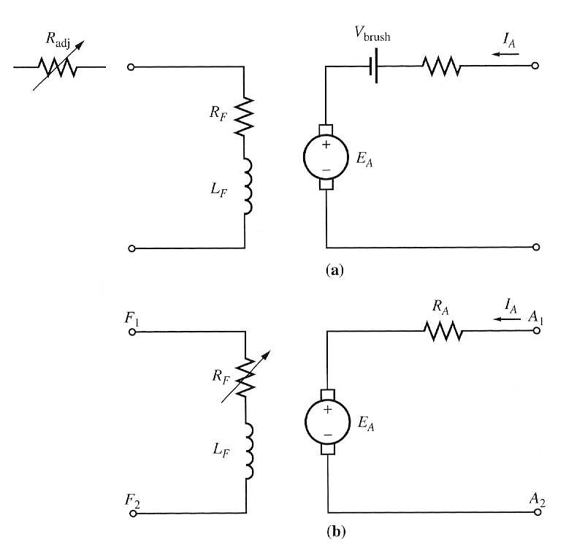
DC Motors
The Equivalent Circuit of a DC Motor
The armature circuit is represented by an ideal voltage source E_{A} and a resistor R_{A}. The brush voltage drop is represented by a small battery V_{brush} opposing the direction of current flow in the machine. A simplified equivalent circuit eliminating the brush voltage drop

Slide 2
DC Motors
The Equivalent Circuit of a DC Motor
The field coils, which produce the magnetic flux in the motor are represented by inductor L_{F} and resistor R_{F}. The separate resistor R_{adj} represents an external variable resistor used to control the amount of current in the field circuit. A simplified equivalent circuit combining R_{adj} with the field resistance.

Slide 3
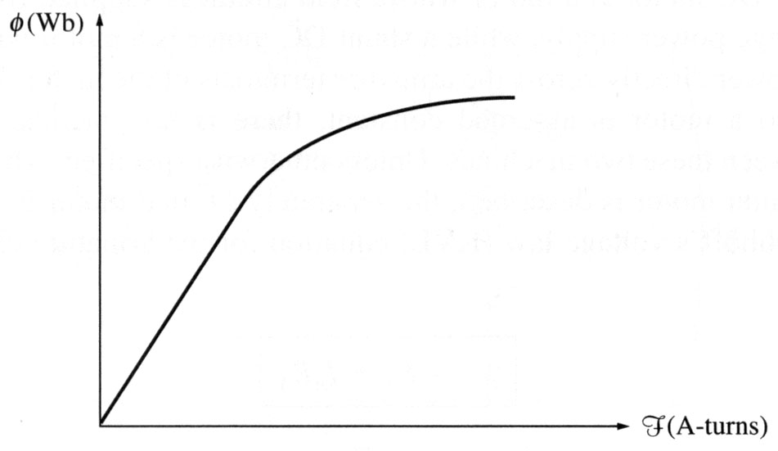
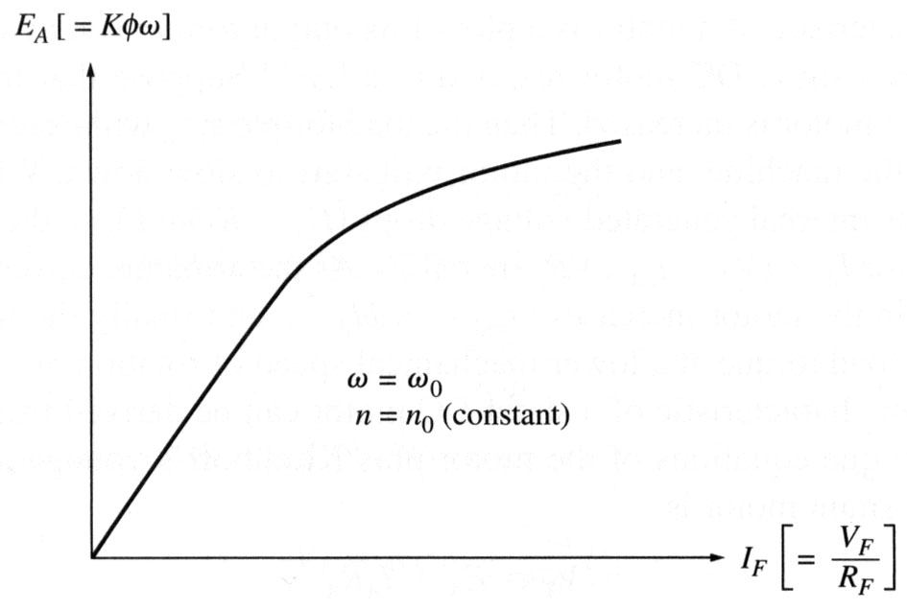

DC Motors
The Magnetization Curve of a DC Machine
or in terms of internal voltage vs. field current for a given speed
E_{A} is directly proportional to flux and the speed of rotation of the machine. The field current produces a field mmf given by F=N_{F}I_{F}. This mmf produces a flux in the machine in accordance with its magnetization curve. Since the field current is directly proportional to the mmf and since E_{A} is directly proportional to flux, it is customary to present the magnetization curve as a plot of E_{A} vs field current for a given speed ω_{o}.

Slide 4
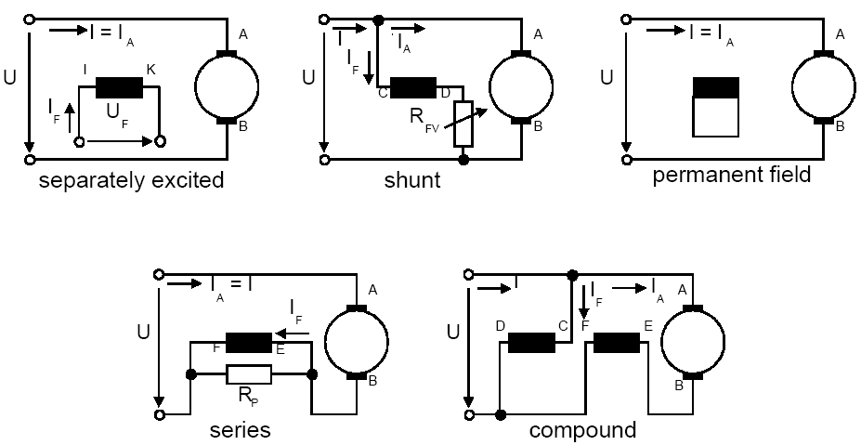
DC Motors
DC Machine excitation
The operational behavior of DC machines is dependent on the exciter winding interconnection type.

Slide 5
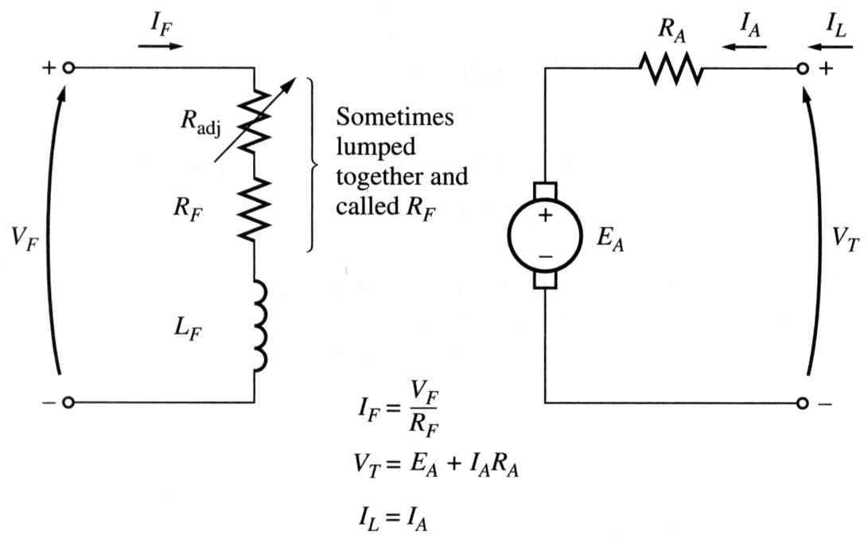
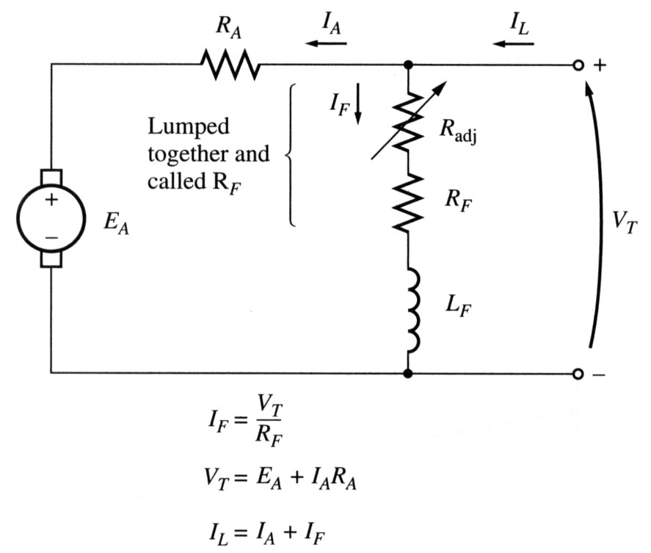

Motor types: Separately excited and Shunt DC motors
Note: when the voltage to the field circuit is assumed constant, there is no difference between them.
Separately excited DC motor:
a field circuit is supplied from a separate constant voltage power source.
Shunt DC motor:
a field circuit gets its power from the armature terminals of the motor.
For the armature circuit of these motors:

Slide 6
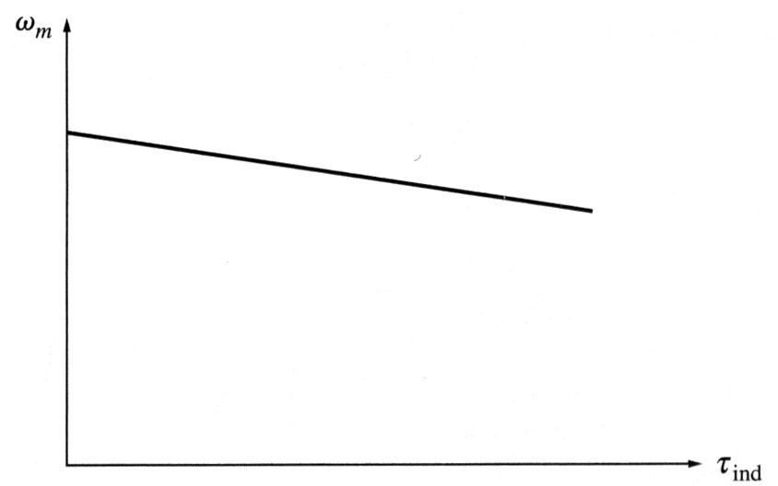

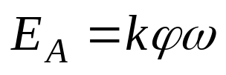
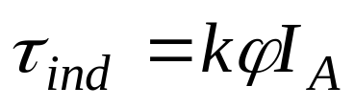
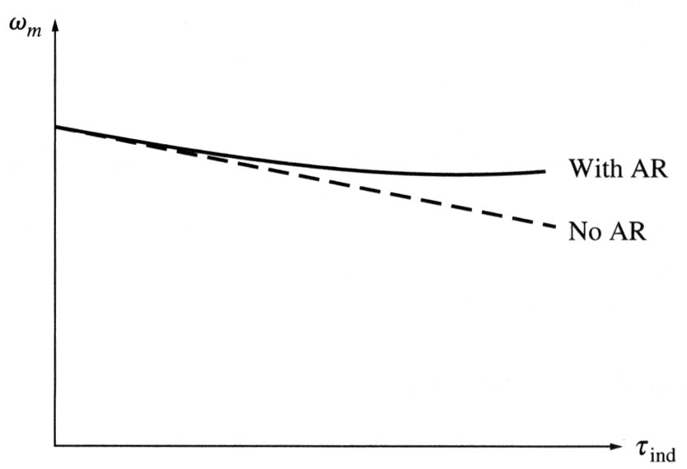
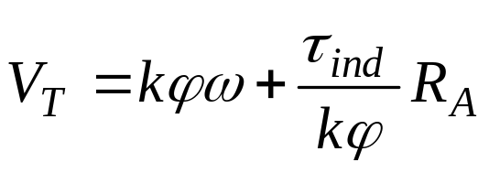
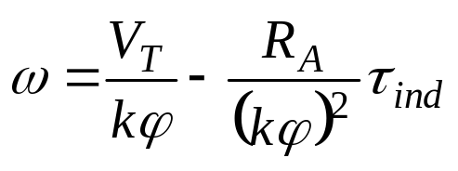
DC Motors
The output characteristics of the shunt DC motor
If a motor has armature reaction, then as its load increases, the flux-weakening effects reduce its flux. The effect of reduction in flux is to increase the motor speed.

Slide 7
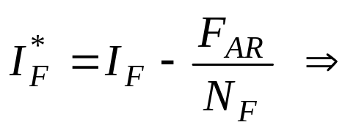
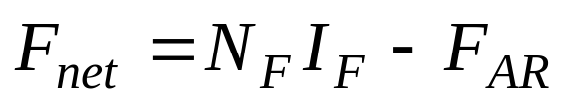
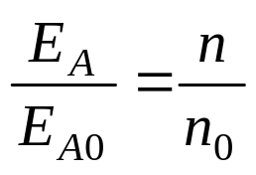
DC Motors
Nonlinear Analysis of a Shunt DC Motor
The internal generated voltage E_{A} is a non linear function of the magnetomotive force. If a machine has armature reaction, its flux will be reduced with each increase in load. The total mmf in a shunt dc motor is the field circuit mmf less the mmf due to armature reaction.
It is customary to define an equivalent field current that would produce the same output voltage as the combination of all the mmf in the machine.
E_{A} is related to speed by:

Slide 8
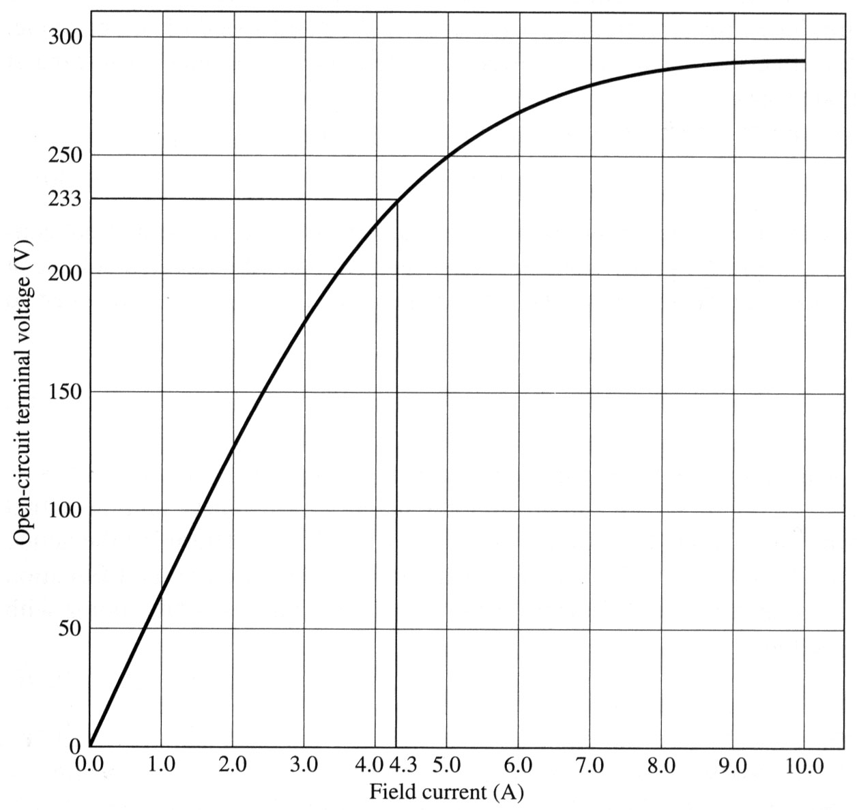
DC Motors
Example
A 50HP, 250V, 1200r/min DC shunt motor without compensating windings has an armature resistance (including the brushes and interpoles) of 0.06 Ω. Its field circuit has a total resistance R_{adj}+ R_{F} of 50 Ω, which produces a no-load speed of 1200r/min. There are 1200 turns per pole on the shunt field winding, and the armature reaction produces a demagnetising magnetomotive force of 840 A-turns at a load current of 200A. The magnetization curve of this machine is given.
Find the speed of this motor when its input current is 200A.

Slide 9
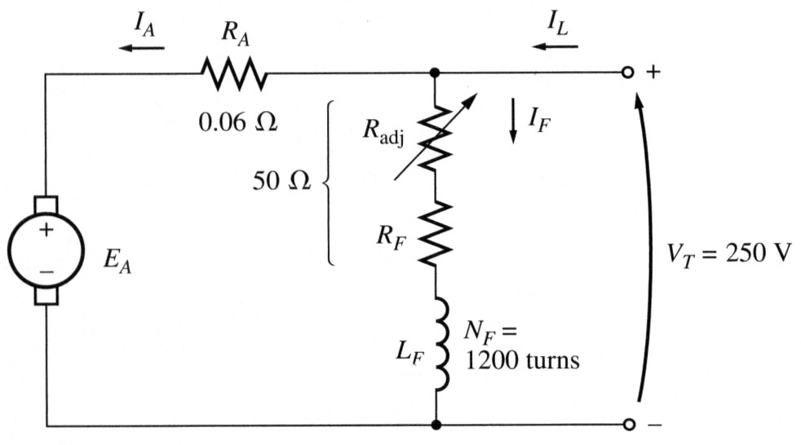
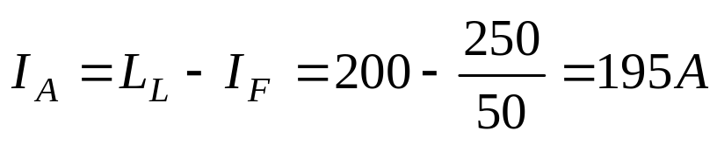

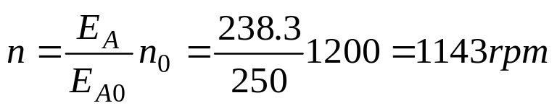
DC Motors
Example
If we neglect armature reaction then:

Slide 10
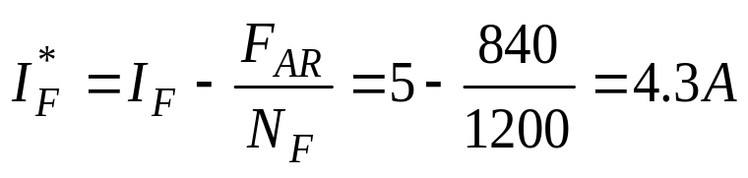

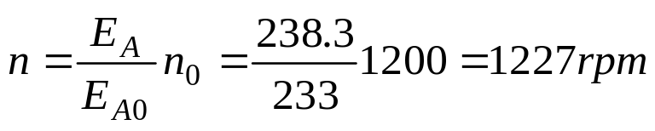
DC Motors
Example
But the armature reaction reduces the effective filed current:
From the magnetization curve, this effective field current will produce an internal voltage of E_{A0} = 233 V at a speed of 1200 rpm. Hence for the voltage of E_{A0} = 283.3 , the speed is:

Slide 11
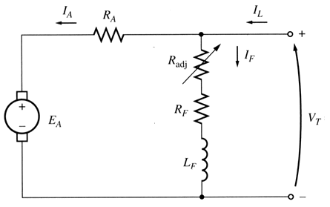
DC Motors
Speed Control of Shunt/Separately-Exited DC Motors
Two common methods:
Adjusting the field resistance RF (and thus the field flux)
Adjusting the terminal voltage applied to the armature (Separately-excited motor).
Less common method:
Inserting a resistor in series with the armature circuit.

Slide 12
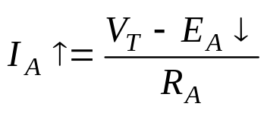

DC Motors
Speed Control of Shunt DC Motors
Changing the Field Resistance
If the field resistance increases, then the field current decreases (I_{F}↓ = V_{T}/R_{F}↑), and as the field current decreases, the flux decreases as well. A decrease in flux causes an instantaneous decrease in the internal generated voltage E_{A}↓ (=K_{f}↓ω), which causes a large increase in the machine’s armature current since:
The induced torque in a motor is given by τ_{ind} =KφI_{A}. the increase in current predominates over the decrease in flux. so, τ_{ind}>τ_{load} , the motor speeds up.
However, as the motor speeds up, E_{A} rises, causing I_{A} to fall. Thus, induced torque τ_{ind} drops too, and finally τ_{ind} equals τ_{load} at a higher steady-sate speed than originally.

Slide 13
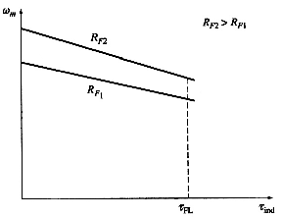
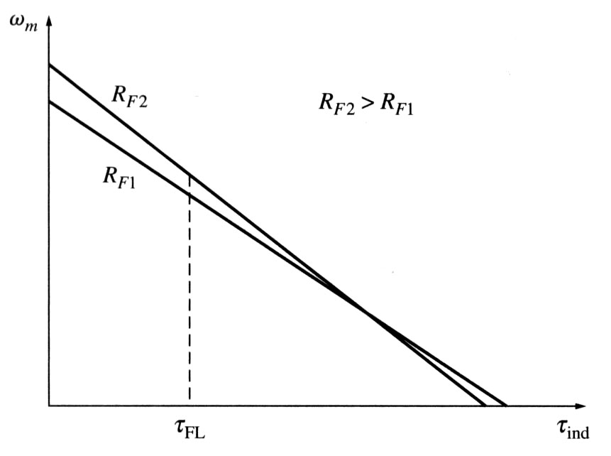
DC Motors
Speed Control of Shunt DC Motors
Changing the Field Resistance
Notice that as the flux in the machine decreases, the no-load speed of the motor increases, while the slope of the torque-speed curve becomes steeper. At very slow speeds an increase in field resistance will actually decrease the speed of the motor. This effect occurs because, at very high torque, the increase in armature current caused by the decrease in E_{A} is no longer large enough to compensate for the decrease in flux in the induced torque equation.

Slide 14
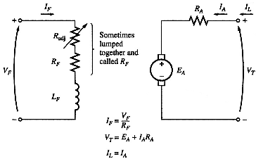
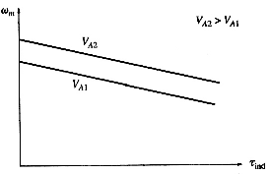
DC Motors
Speed Control of separately excited DC Motors
Changing the Armature Voltage (most common)
If the voltage V_{A} is increased, then the I_{A} must rise;
[ I_{A} = (V_{A} ↑ -E_{A})/R_{A}]. As I_{A} increases, the induced torque τ_{ind} =K_{f}I_{A}↑ increases, making τ_{ind} > τ_{load} , and the speed of the motor increases.
But, as the speed increases, the E_{A} (=K_{f}ω↑) increases, causing the armature current to decrease. This decrease in I_{A} decreases the induced torque, causing τ_{ind} = τ_{load} at a higher rotational speed.

Slide 15
DC Motors
Speed Control of separately excited DC Motors
Ranges of Operation
Since an increase in field current causes decrease in speed, there is always a minimum achievable speed by field circuit control. This minimum speed occurs when the motor’s field circuit has the maximum permissible current flowing through it. Armature voltage control can control the speed of the motor for speeds below base speed but not for speeds above base speed. To achieve a speed faster than base speed by armature voltage control would require excessive armature voltage, possibly damaging the armature circuit (or even may not be available). These two techniques of speed control are obviously complementary. Armature voltage control works well for speeds below base speed, and field resistance control works well for speeds above base speed

Slide 16
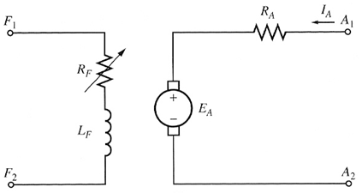
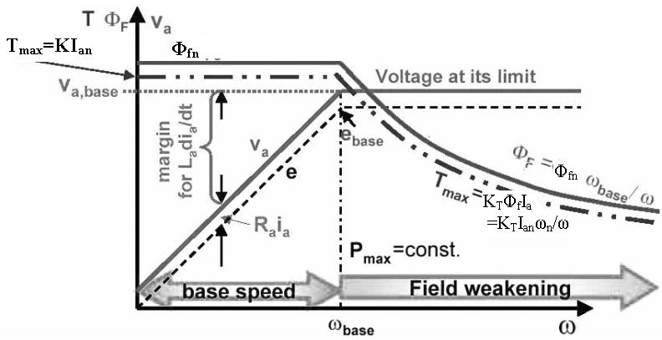
DC Motors
Speed Control of separately excited DC Motors
Ranges of Operation

Slide 17
DC Motors
Speed Control of separately excited DC Motors
Ranges of Operation
For armature voltage control, the flux in the motor is constant, so the maximum torque in the motor is τ_{max} =K_{f}I_{A,max}. This maximum torque is constant regardless of the speed of the rotation of the motor. Since the power out of the motor is given by P=τω, the maximum power is P_{max} = τ_{max} ω. When field resistance control is used, a speed increase is caused by a decrease in the machine’s flux. In order for the armature current limit is not exceeded, the induced torque limit must decrease as the speed of the motor increases. Since the power out of the motor is given by P=τω and the torque limit decreases as the speed of the motor increases, the max power out of a dc motor under field current control is constant, while the maximum torque varies as the reciprocal of the motor’s speed.

Slide 18
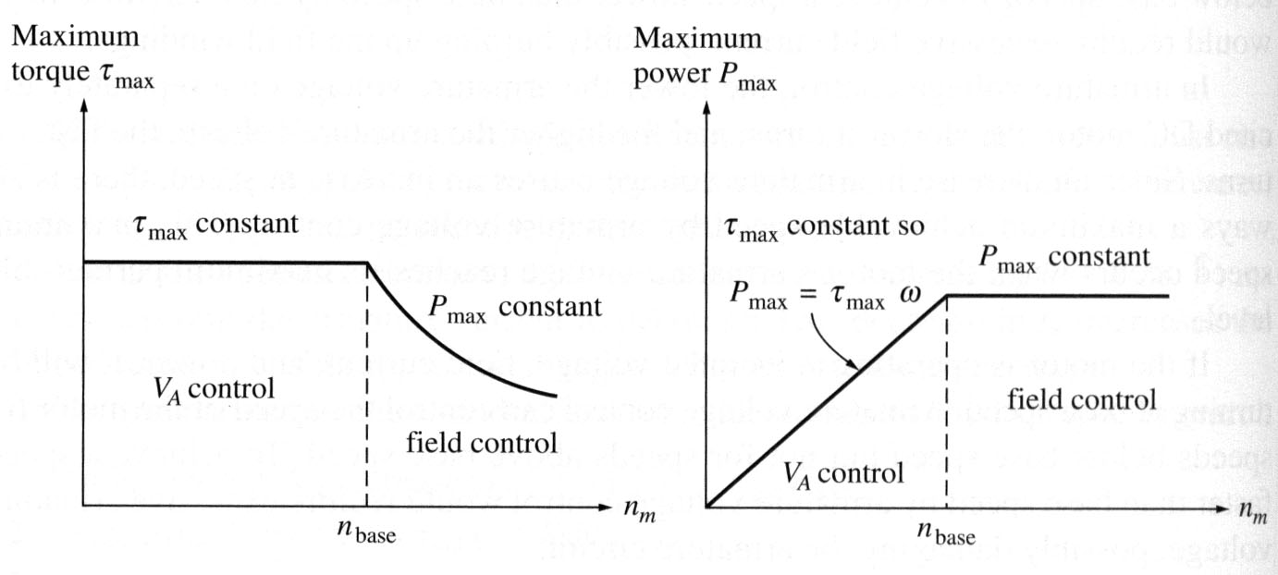

DC Motors
Speed Control of separately excited DC Motors
Ranges of Operation

Slide 19
Shunt motor: Speed control: Ex
Example : A 100 hp, 250 V, 1200 rpm DC shunt motor with an armature resistance of 0.03 Ω and a field resistance of 41.67 Ω. The motor has compensating windings, so armature reactance can be ignored. Mechanical and core losses may be ignored also. The motor is driving a load with a line current of 126 A and an initial speed of 1103 rpm. Assuming that the armature current is constant and the magnetization curve is
What is the motor speed if the field resistance is increased to 50 Ω?
Calculate the motor speed as a function of the field resistance, assuming a constant-current load.
Assuming that the motor next is connected as a separately excited and is initially running with V_{A} = 250 V, I_{A} = 120 A and at n = 1103 rpm while supplying a constant-torque load, estimate the motor speed if V_{A} is reduced to 200 V.

Slide 20
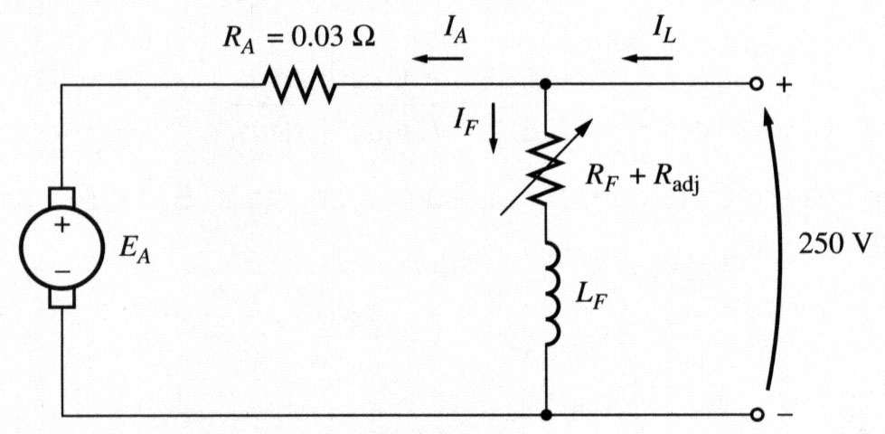
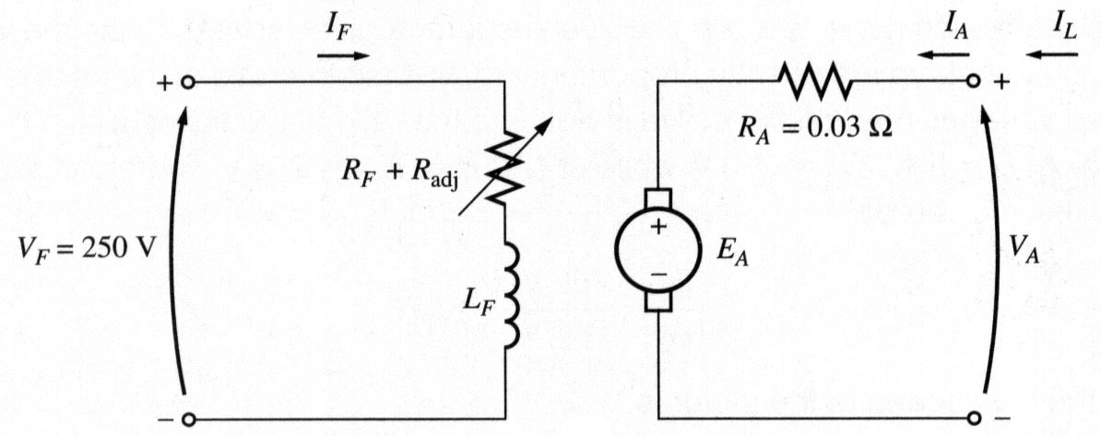
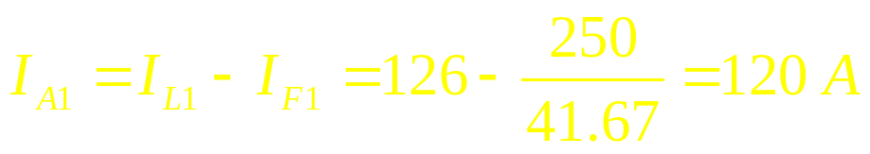
Shunt motor: Speed control: Ex
shunt
separately-excited
For the given initial line current of 126 A, the initial armature current will be
Therefore, the initial generated voltage for the shunt motor will be

Slide 21
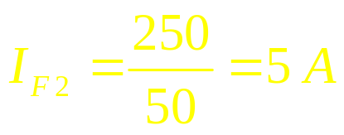
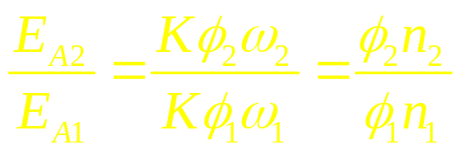
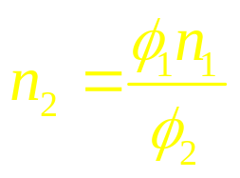
Shunt motor: Speed control: Ex
After the field resistance is increased to 50 Ω, the new field current will be
The ratio of the two internal generated voltages is
Since the armature current is assumed constant, E_{A1} = E_{A2} and, therefore
The values of E_{A} on the magnetization curve are directly proportional to the flux. Therefore, the ratio of internal generated voltages equals to the ratio of the fluxes within the machine. From the magnetization curve, at I_{F} = 5A, E_{Aα} = 250V, and at I_{F} = 6A, E_{Aβ} = 268V. Thus:

Slide 22
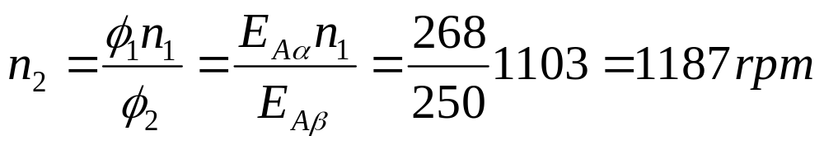
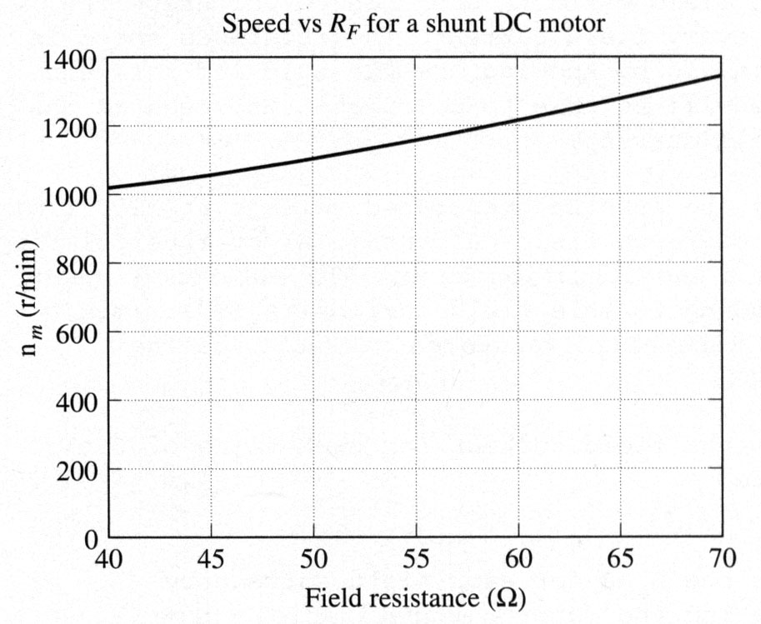
Shunt motor: Speed control: Ex
b) A speed vs. R_{F} characteristic is shown below:

Slide 23

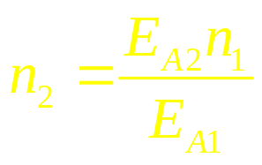
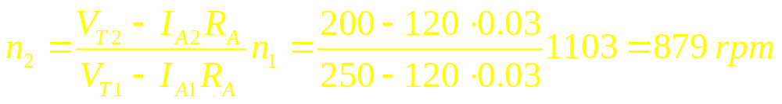
Shunt motor: Speed control: Ex
c) For a separately excited motor, the initial generated voltage is
and since the flux φ is constant
Since the both the torque and the flux are constants, the armature current I_{A} is also constant. Then

Slide 24
Shunt motor: The effect of an open field circuit
If the field circuit is left open on a shunt motor, its field resistance will be infinite. Infinite field resistance will cause a drastic flux drop and, therefore, a drastic drop in the generated voltage. The armature current will be increased enormously increasing the motor speed.
A similar effect can be caused by armature reaction. If the armature reaction is severe enough, an increase in load can weaken the flux causing increasing the motor speed. An increasing motor speed increases its load, which increases the armature reaction weakening the flux again. This process continues until the motor overspeeds. This condition is called runaway.

